Slide 1
Neural Spectrospatial Filter
DeLiang Wang
(Joint work with Ke Tan and Zhong-Qiu Wang)
Perception & Neurodynamics Lab
Ohio State University

Slide 2
Outline
Background
DNN based binaural speech separation
Masking based beamforming
Complex spectral mapping approach to speech dereverberation and speaker separation
Neural spectrospatial filter
Notes:
2

Slide 3
DNN based approach
Jiang et al. (2014) first proposed DNN classification of binaural features for reverberant speech enhancement
Interaural time difference (ITD) and interaural level difference (ILD)
Using binaural features to train a DNN classifier to estimate the IBM (ideal binary mask)
Monaural features are also used
With reasonable sampling of spatial configuration, the classifier generalizes well to untrained configurations and reverberation conditions

Slide 4
Combining spatial and spectral analyses
More recently, Zhang & Wang (2017) used a more sophisticated set of spatial and spectral features
Separation is based on IRM (ideal ratio mask) estimation
Spectral features are extracted after fixed beamforming
Substantially outperform conventional beamformers

Slide 5
Masking based beamforming
Beamforming as a spatial filter needs to know the target direction for steering purposes
Steering vector typically relies on direction-of-arrival estimation of the target source, or source localization
However, sound localization in reverberant, multi-source environments itself is difficult
For human audition, localization seems to depend instead on separation (Darwin’08)

Slide 6
Masking based beamforming (cont.)
A more recent idea uses monaural time-frequency (T-F) masking to guide beamforming (Heymann et al.’16; Higuchi et al.’16)
Supervised masking helps to specify the target source
Masking helps also by suppressing interfering sound sources

Slide 7
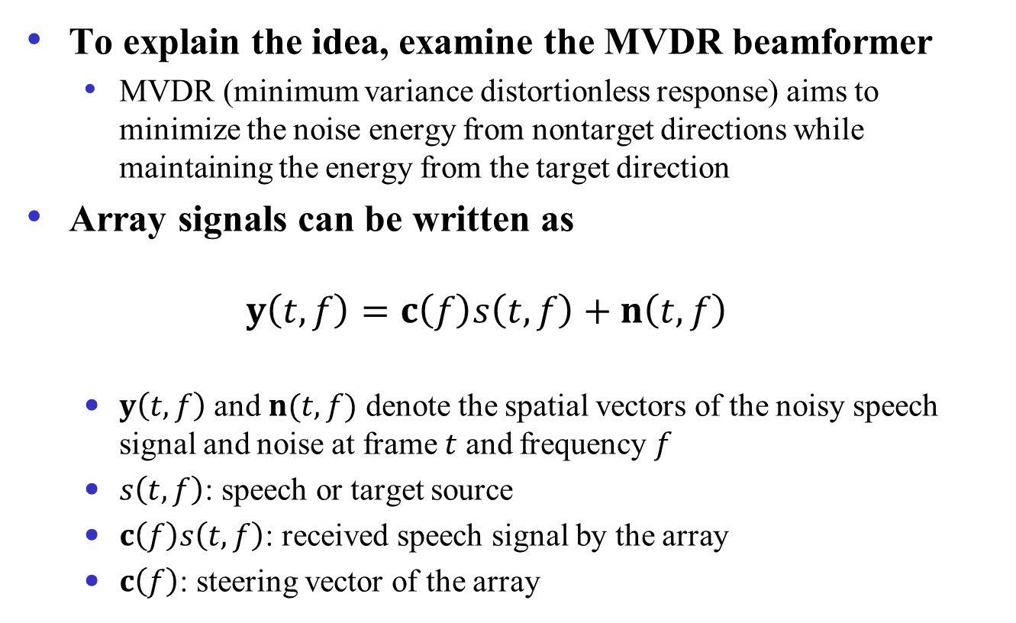
MVDR beamformer
To explain the idea, examine the MVDR beamformer
MVDR (minimum variance distortionless response) aims to minimize the noise energy from nontarget directions while maintaining the energy from the target direction
Array signals can be written as
$$y\left(t,f\right)=c\left(f\right)s\left(t,f\right)+n\left(t,f\right)$$
$y\left(t,f\right)$ and $n(t,f)$ denote the spatial vectors of the noisy speech signal and noise at frame $t$ and frequency $f$
$s\left(t,f\right)$: speech or target source
$c\left(f\right)s\left(t,f\right)$: received speech signal by the array
$c\left(f\right)$: steering vector of the array

Slide 8
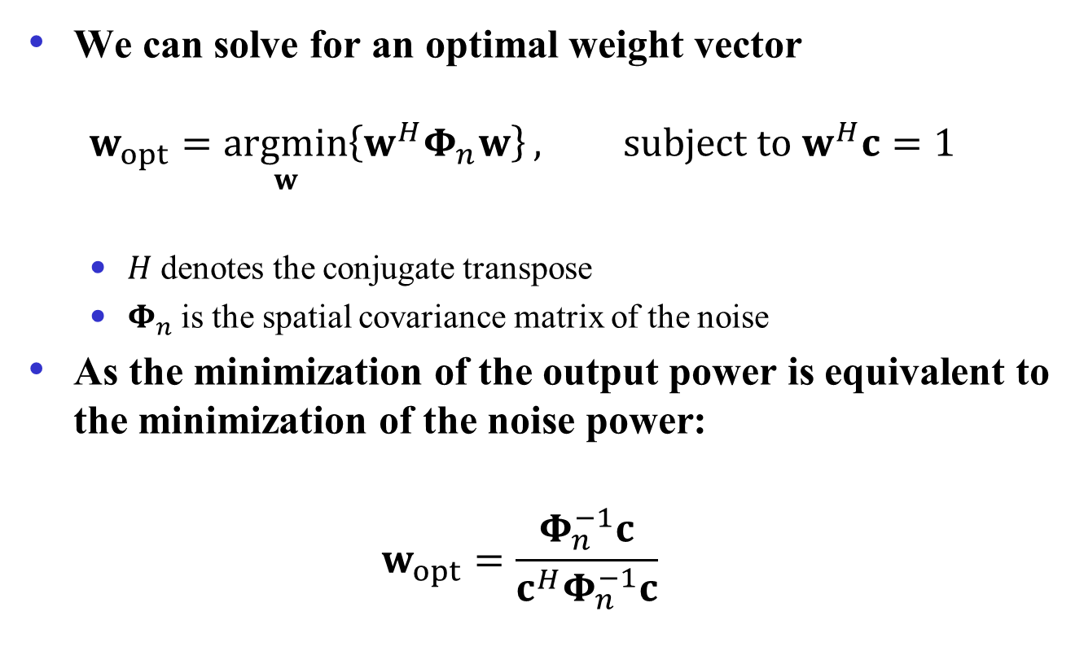
MVDR beamformer (cont.)
We can solve for an optimal weight vector
$$w_{opt}=\underset{w}{argmin}\left\{w^{H}Φ_{n}w\right\}, subject to w^{H}c=1$$
$H$ denotes the conjugate transpose
$Φ_{n}$ is the spatial covariance matrix of the noise
As the minimization of the output power is equivalent to the minimization of the noise power:
$$w_{opt}=\frac{Φ_{n}^{−1}c}{c^{H}Φ_{n}^{−1}c}$$

Slide 9
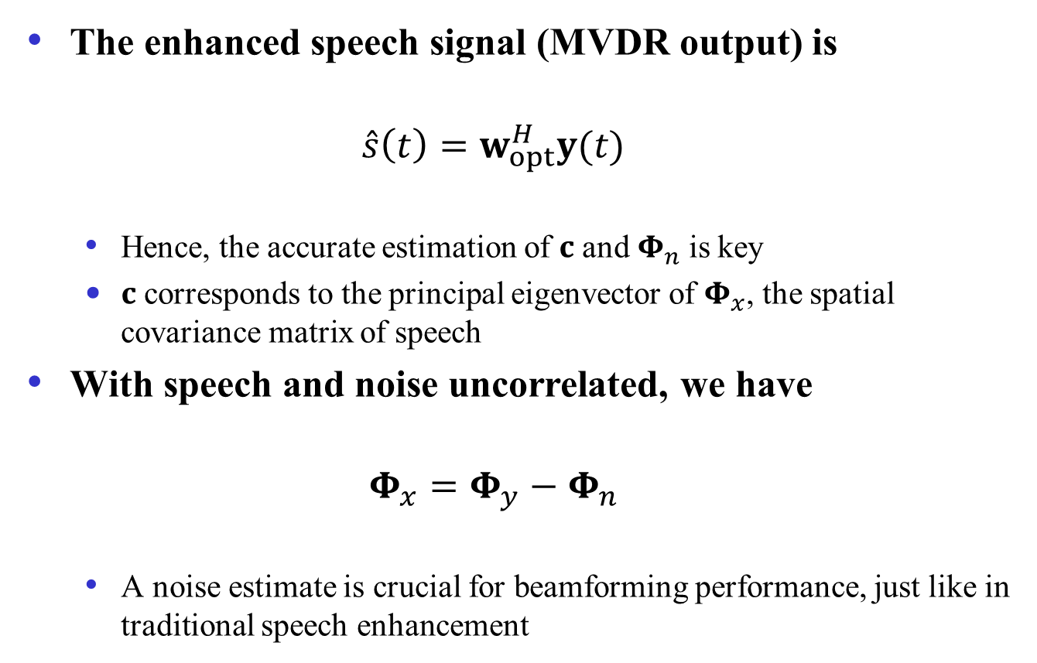
MVDR beamformer (cont.)
The enhanced speech signal (MVDR output) is
$$\hat{s}\left(t\right)=w_{opt}^{H}y(t)$$
Hence, the accurate estimation of $c$ and $Φ_{n}$ is key
$c$ corresponds to the principal eigenvector of $Φ_{x}$, the spatial covariance matrix of speech
With speech and noise uncorrelated, we have
$$Φ_{x}=Φ_{y}−Φ_{n}$$
A noise estimate is crucial for beamforming performance, just like in traditional speech enhancement

Slide 10
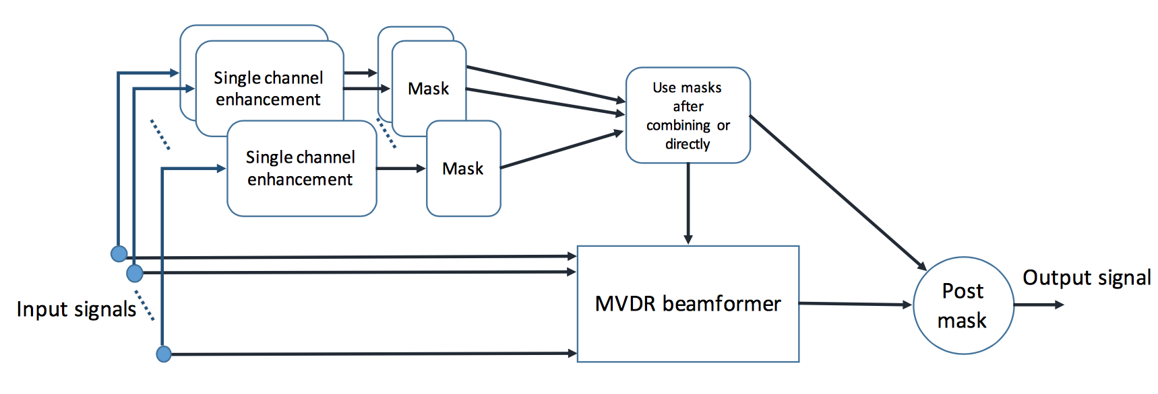
Masking based beamforming
A T-F mask provides a way to more accurately estimate noise (and speech) covariance matrix from noisy input
Heymann et al. (2016) use RNN with LSTM (long short-term memory) for monaural IBM estimation
Higuchi et al. (2016) compute a ratio mask using a spatial clustering method
From Erdogan et al. (2016)

Slide 11
Masking based beamforming (cont.)
Masking based beamforming is responsible for impressive ASR results on CHiME-3 and CHiME-4 challenges
These results are much better than using traditional beamformers
Masking based beamforming represents a major advance in beamforming based separation and multi-channel automatic speech recognition (ASR)

Slide 12
Outline
Background
DNN based binaural speech separation
Masking based beamforming
Complex spectral mapping approach to speech dereverberation and speaker separation
Neural spectrospatial filter
Notes:
12

Slide 13
Complex spectral mapping
We have proposed to address multi-channel speech dereverberation using the complex spectral mapping (CSM) approach (Wang & Wang’20)
Based on the strategy of target cancellation
Single-channel dereverberation is treated as a special case
Notes:
13

Slide 14

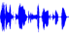
Multi-channel reverberant recordings
Reverberation corresponds to an infinite number of delayed and attenuated copies of an original sound source
A dereverberation method needs to also consider diffuse background noise
Reverberant room
Microphone array
Reflections
Direct-path signal
Speaker
Diffuse Noise
Notes:
14

Slide 15
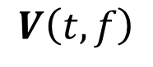
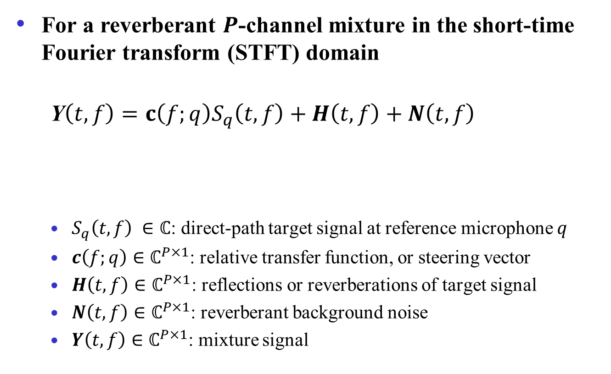
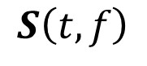
Signal model for reverberant-noisy speech
For a reverberant $P$-channel mixture in the short-time Fourier transform (STFT) domain
Y$\left(t,f\right)=c\left(f;q\right)S_{q}\left(t,f\right)+H\left(t,f\right)+N\left(t,f\right)$
$S_{q}\left(t,f\right) ∈ℂ$: direct-path target signal at reference microphone $q$
$c\left(f;q\right)∈ℂ^{P×1}$: relative transfer function, or steering vector
$H\left(t,f\right)∈ℂ^{P×1}$: reflections or reverberations of target signal
$N\left(t,f\right)∈ℂ^{P×1}$: reverberant background noise
$Y\left(t,f\right)∈ℂ^{P×1}$: mixture signal
$$S\left(t,f\right)$$
$$V\left(t,f\right)$$

Slide 16
Complex spectral mapping approach
Phase relations of a sound source between multiple microphones encode spatial characteristics
Complex spectral mapping is a natural approach to represent signal phase in addition to magnitude
This approach employs DNN to predict the real and imaginary (RI) parts of the direct sound from the corresponding reverberant-noisy signal
It uses real-valued DNN to perform complex-domain processing (Williamson et al.’16)
Notes:
16

Slide 17
Two-channel real and imaginary spectrograms
Real and imaginary spectrograms both exhibit clear speech structure, unlike magnitude and phase spectrograms
Real and imaginary parts are related by a phase shift
Both microphones, as well as inter-microphone differences, show speech structure
Notes:
17

Slide 18
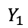
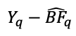
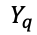
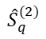

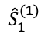
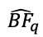
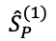
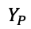
Model diagram
Target cancellation strategy first performs speech dereverberation in individual channels using a common DNN
Dereverberated signals are then fed to an MVDR beamformer
The RI parts of the mixture with the beamformed target signal subtracted are used as additional features to further improve speech dereverberation
Reverberant
Room
Single-channel
Dereverberation
Network
$$Y_{1}$$
$${\hat{S}}_{1}^{(1)}$$
…
$$Y_{q}−{\hat{BF}}_{q}$$
Multi-channel Dereverberation
Network
…
…
…
MVDR
Target Speech
$${\hat{BF}}_{q}$$
$${\hat{S}}_{q}^{(2)}$$
…
Single-channel
Dereverberation
Network
$$Y_{q}$$
$$Y_{P}$$
$${\hat{S}}_{P}^{(1)}$$
$$Y$$
Noise
Shared parameters
Notes:
18

Slide 19
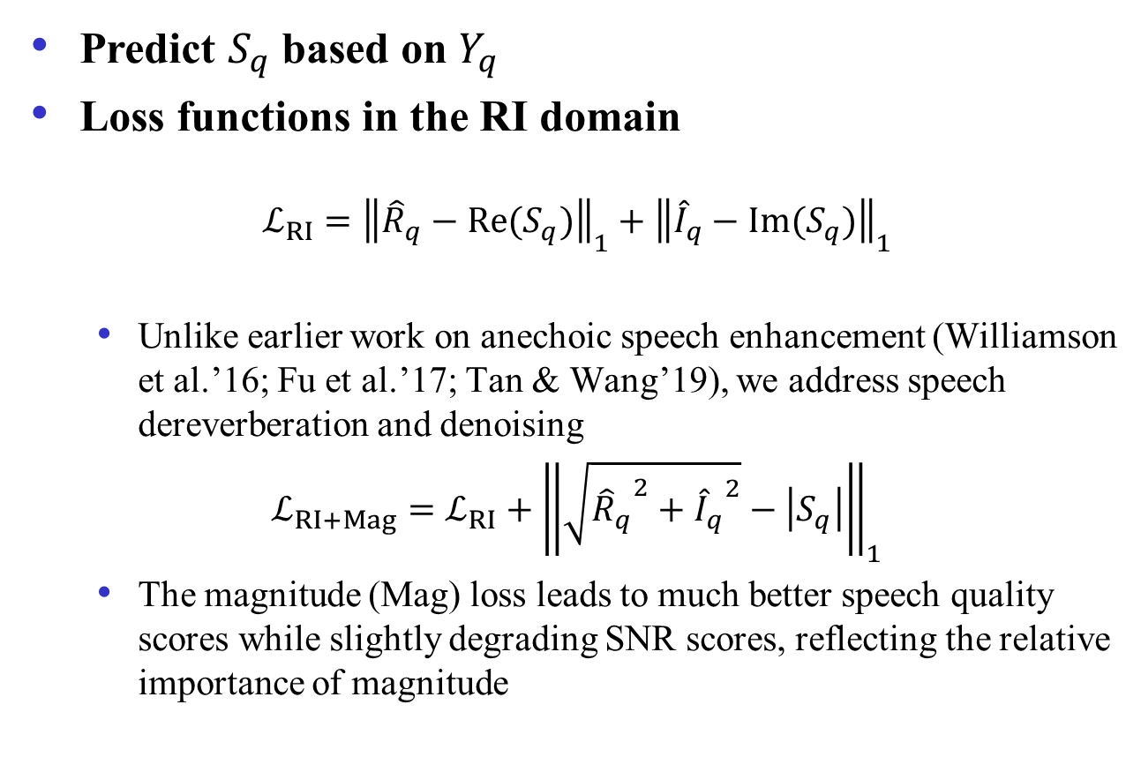
Single-channel complex spectral mapping
Predict $S_{q}$ based on $Y_{q}$
Loss functions in the RI domain
$$ℒ_{RI}={\left\|{\hat{R}}_{q}−Re(S_{q})\right\|}_{1}+{\left\|{\hat{I}}_{q}−Im(S_{q})\right\|}_{1}$$
Unlike earlier work on anechoic speech enhancement (Williamson et al.’16; Fu et al.’17; Tan & Wang’19), we address speech dereverberation and denoising
$$ℒ_{RI+Mag}={ℒ_{RI}+\left\|\sqrt{{{\hat{R}}_{q}}^{2}+{{\hat{I}}_{q}}^{2}}−\left|S_{q}\right|\right\|}_{1}$$
The magnitude (Mag) loss leads to much better speech quality scores while slightly degrading SNR scores, reflecting the relative importance of magnitude
Notes:
19

Slide 20
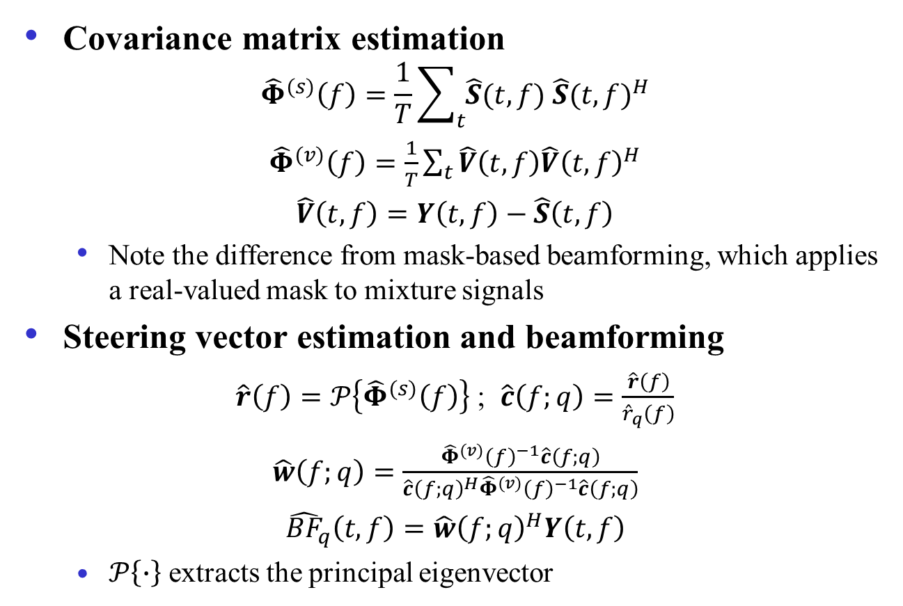
MVDR beamforming
Covariance matrix estimation
$${\hat{Φ}}^{(s)}\left(f\right)=\frac{1}{T}\sum_{t}{\hat{S}(t,f) {\hat{S}(t,f)}^{H}}$$
${\hat{Φ}}^{(v)}\left(f\right)=\frac{1}{T}\sum_{t}{\hat{V}\left(t,f\right){\hat{V}\left(t,f\right)}^{H}}$
$\hat{V}\left(t,f\right)=Y\left(t,f\right)−\hat{S}\left(t,f\right)$
Note the difference from mask-based beamforming, which applies a real-valued mask to mixture signals
Steering vector estimation and beamforming
$\hat{r}\left(f\right)=𝒫\left\{{\hat{Φ}}^{(s)}\left(f\right)\right\}$ ; $\hat{c}\left(f;q\right)=\frac{\hat{r}\left(f\right)}{{\hat{r}}_{q}\left(f\right)}$
$\hat{w}\left(f;q\right)=\frac{{{\hat{Φ}}^{(v)}\left(f\right)}^{−1}\hat{c}\left(f;q\right)}{{\hat{c}\left(f;q\right)}^{H}{{\hat{Φ}}^{(v)}\left(f\right)}^{−1}\hat{c}\left(f;q\right)}$
${{\hat{BF}}_{q}\left(t,f\right)=\hat{w}\left(f;q\right)}^{H}Y\left(t,f\right)$
$𝒫\left\{∙\right\}$ extracts the principal eigenvector
Notes:
20

Slide 21
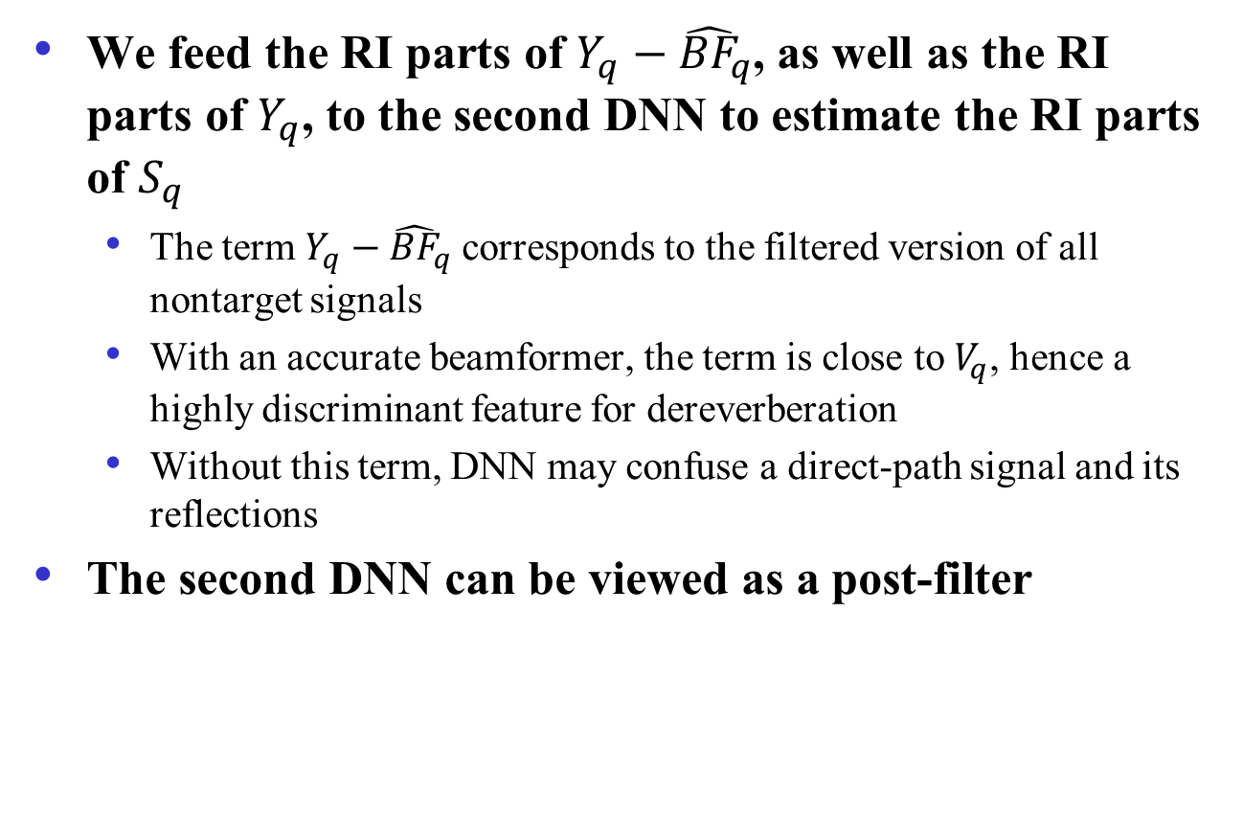
Multi-channel dereverberation
We feed the RI parts of ${Y_{q}−\hat{BF}}_{q}$, as well as the RI parts of $Y_{q}$, to the second DNN to estimate the RI parts of $S_{q}$
The term ${Y_{q}−\hat{BF}}_{q}$corresponds to the filtered version of all nontarget signals
With an accurate beamformer, the term is close to $V_{q}$, hence a highly discriminant feature for dereverberation
Without this term, DNN may confuse a direct-path signal and its reflections
The second DNN can be viewed as a post-filter
Notes:
21

Slide 22
REVERB challenge evaluation
Train on simulated RIRs (room impulse responses) and WSJCAM0 speech corpus
Evaluate the trained models, without retraining, on the REVERB challenge dataset (Kinoshita et al.’16)
Simulated noisy-reverberant utterances using measured RIRs
Recorded noisy-reverberant utterances
Eight-microphone circular array with radius fixed at 10 cm
T60 in the range [0.25, 0.7] s
Speaker to array distance in the range [0.5, 2.5] m
Air conditioning noise
Baselines
Single- and multi-channel weighted prediction error (WPE) method (Nakatani et al.’10) with or without further beamforming
Notes:
22

Slide 23
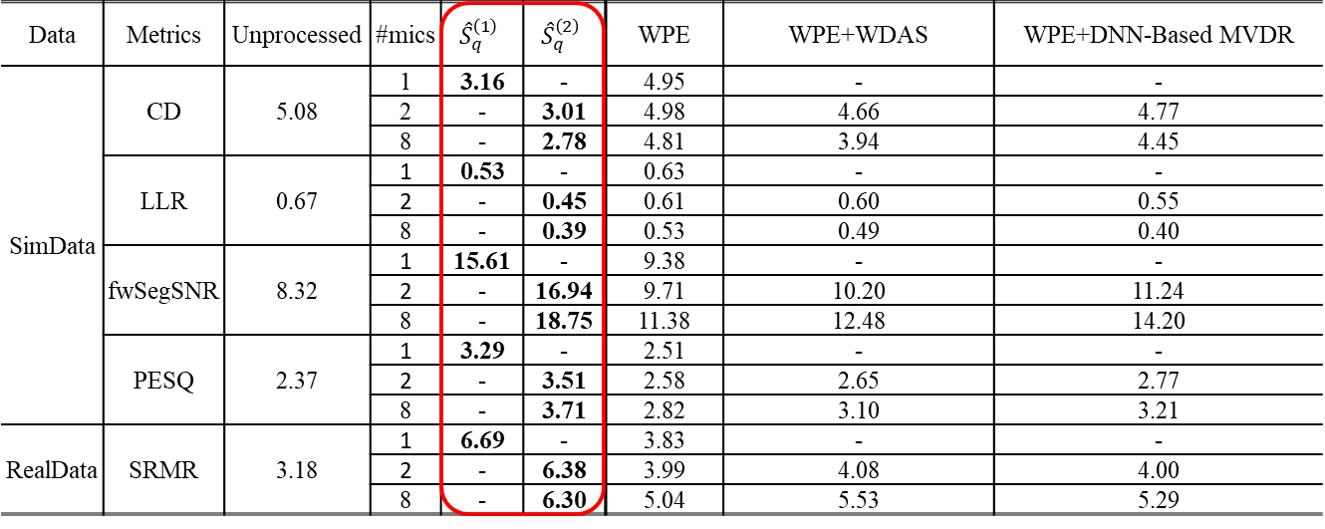
Dereverberation results on REVERB test data
Clear improvements over WPE, WPE+WDAS (weighted delay-and-sum beamformer), and WPE+DNN-based MVDR
Acronyms: CD: cepstral distance; LLR: log likelihood ratio; SRMR: speech-to-reverberation modulation energy ratio
Notes:
23

Slide 24
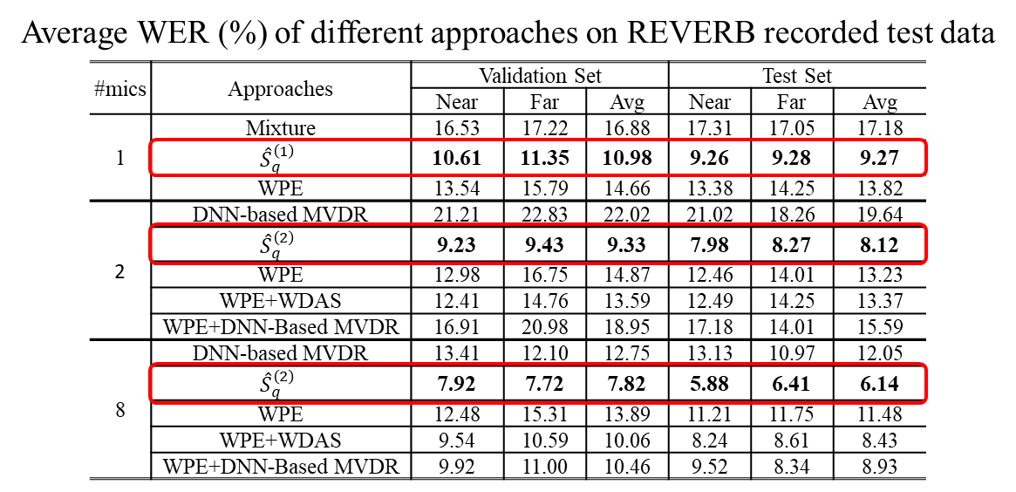
ASR results on REVERB real test data
Clear improvements over WPE, WPE+WDAS, and WPE+DNN-based MVDR
WER: word error rate
Notes:
24

Slide 25

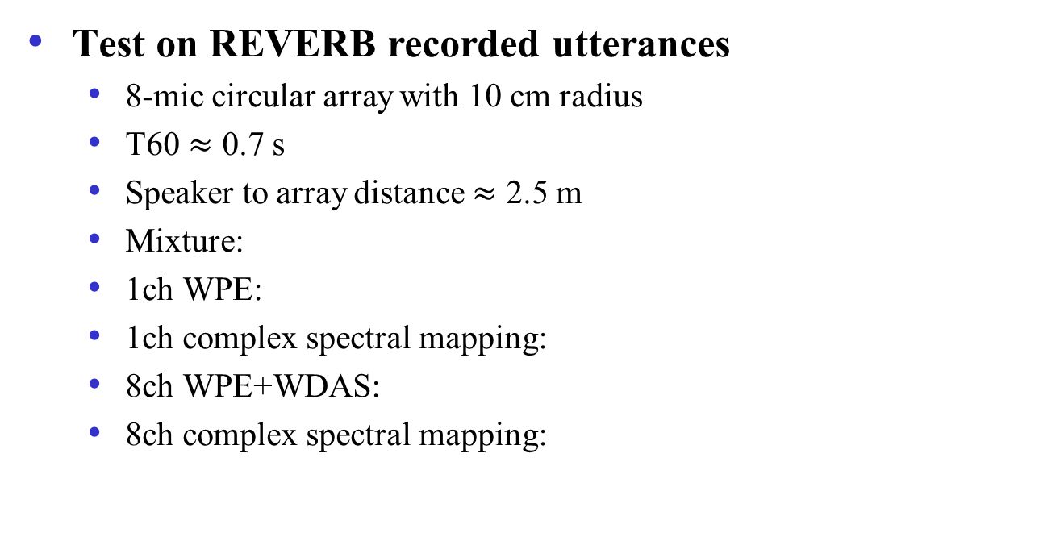
Sound demo
Test on REVERB recorded utterances
8-mic circular array with 10 cm radius
T60 $≈$ 0.7 s
Speaker to array distance $≈$ 2.5 m
Mixture:
1ch WPE:
1ch complex spectral mapping:
8ch WPE+WDAS:
8ch complex spectral mapping:
Notes:
25

Slide 26
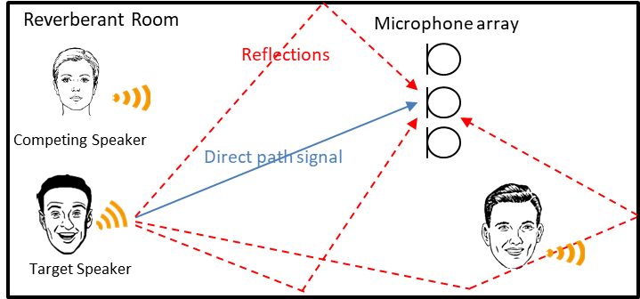
Multi-channel speaker separation
Major advances are made in monaural talker-independent speaker separation
Representative approaches: deep clustering (Hershey et al.’16), permutation-invariant training (PIT) (Kolbak et al.’17)
Multi-channel recordings provide a spatial dimension that may further improve separation performance
Notes:
26

Slide 27
MISO-based architecture
We have proposed a MISO (multi-input and single-output) module, resulting in MISO-BF-MISO architecture (Wang et al.’21)
TI-MVDR: time-invariant MVDR
Source alignment through utterance-level PIT
Shared parameters
$$\left\langle Y_{q},…,Y_{P},Y_{1},…,Y_{q−1}\right\rangle$$
Multi-Channel
Separation
Network (MISO₁)
$${\hat{S}}_{1}^{\left(1\right)′}(1)$$
Source Alignment across Microphones
$${\hat{S}}_{1}^{\left(1\right)}(1)$$
$$Y$$
$$\left\langle Y_{1},…,Y_{P}\right\rangle$$
…
Multi-Channel Enhancement Network (MISO₂)
Reverb Room
$${\hat{S}}_{1}^{\left(1\right)′}(2)$$
$${\hat{S}}_{q}^{\left(1\right)}(1)$$
TI-MVDR
$${\hat{BF}}_{q}(1)$$
$${\hat{S}}_{q}^{\left(2\right)}(1)$$
…
…
…
…
…
$${\hat{S}}_{q}^{\left(1\right)′}(1)$$
$${\hat{S}}_{P}^{\left(1\right)}(1)$$
Speaker 1
$$\left\langle Y_{q},…,Y_{P},\right.$$
$$\left.Y_{1},…,Y_{q−1}\right\rangle$$
Multi-Channel
Separation
Network (MISO₁)
Shared parameters
…
$${\hat{S}}_{q}^{\left(1\right)′}(2)$$
$${\hat{S}}_{1}^{\left(1\right)}(2)$$
Speaker 2
…
…
…
…
TI-MVDR
Multi-Channel Enhancement Network (MISO₂)
Multi-Channel
Separation
Network (MISO₁)
$${\hat{S}}_{P}^{{\left(1\right)}^{′}}(1)$$
$${\hat{S}}_{q}^{(1)}(2)$$
$${\hat{BF}}_{q}(2)$$
$${\hat{S}}_{q}^{\left(2\right)}(2)$$
Noise
$$\left\langle Y_{P},Y_{1},\right.$$
$$\left.…,Y_{P−1}\right\rangle$$
…
$${\hat{S}}_{P}^{\left(1\right)′}(2)$$
$${\hat{S}}_{P}^{\left(1\right)}(2)$$
$$Y$$
$$\left\langle Y_{q},…,Y_{P},Y_{1},…,Y_{q−1}\right\rangle$$
Notes:
27

Slide 28
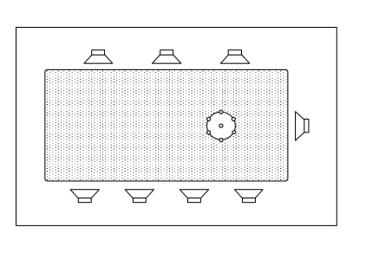
Libri-CSS evaluation
Libri-CSS for continuous speech separation (CSS) contains recorded conversational data by playing LibriSpeech utterances through loudspeakers in a reverberant room (Chen et al.’20)
Baseline models
A mask-based beamforming method provided with the dataset using the default ASR backend (Chen et al.’20)
An updated version of the above method with a more powerful end-to-end ASR backend (Chen et al.’20a)
Notes:
28

Slide 29
Libri-CSS utterance-wise results
Our WER results are better than the strong baselines, particularly with the default ASR backend
0S and 0L indicate no overlap with short and long inter-utterance silence
Adding magnitude features to RI parts leads to ASR improvements
Notes:
29

Slide 30
Continuous-input results
Similar profile of results to the utterance-wise case, but worse overall as expected
Adding a trained speaker counting (SC) module yields clearly better ASR results
Notes:
30

Slide 31
Outline
Background
DNN based binaural speech separation
Masking based beamforming
Complex spectral mapping approach to speech dereverberation and speaker separation
Neural spectrospatial filter
Notes:
31

Slide 32
Motivation and introduction
For a fixed array with stable spatial information, do we really need a beamformer?
In other words, can multi-channel complex spectral mapping fully utilize both spectral and spatial cues?
The answer, we believe, is yes
All discriminative features are contained in the multi-channel complex spectrograms of a mixed signal
The complex representation in MC-CSM (multi-channel CSM) naturally encodes inter-channel phase relations
Single-channel processing is, by definition, a special case
Let deep learning figure out the most discriminative spectral and spatial features for performing a particular task
We call this processing neural spectrospatial filtering (Tan et al.’22)
Notes:
32

Slide 33
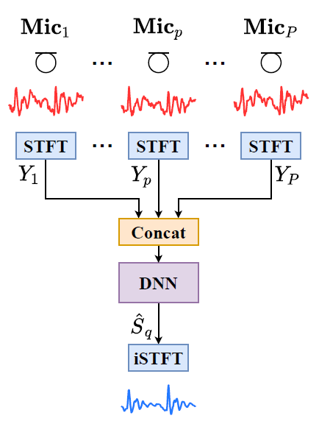
Neural spectrospatial filter
The spectrospatial filter operates on the single-channel spectral inputs of individual microphones, as well as inter-channel spatial cues implicitly available through the complex representation
This all-neural approach is conceptually simple and computationally efficient, compared to mask-based beamforming followed by single-channel postfiltering
Notes:
33

Slide 34
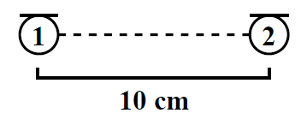
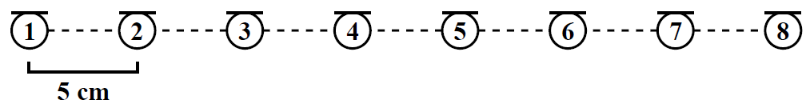
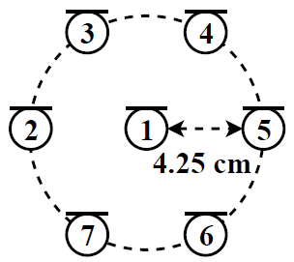
How does the spectrospatial filter perform?
We have systematically evaluated the spectrospatial filter and compared with related approaches using three array geometries
2-channel linear array
8-channel linear array
7-channel circular array
Notes:
34

Slide 35
Comparison baselines
Oracle delay-and-sum (DS), time-invariant TI-MVDR and time-varying MVDR (TV-MVDR)
Target direction is provided to DS, or premixed target and interference are used in covariance matrix calculations
Mask-based (MB) TI-MVDR
DNN is trained to estimate the IRM
CSM-based TI-MVDR (CSM TI-MVDR) and CSM TV-MVDR
DNN-estimated target and interference are used in covariance matrix calculations
Postfilter (PF) can be added
DNN is trained to estimate the IRM or complex spectrogram
Notes:
35

Slide 36
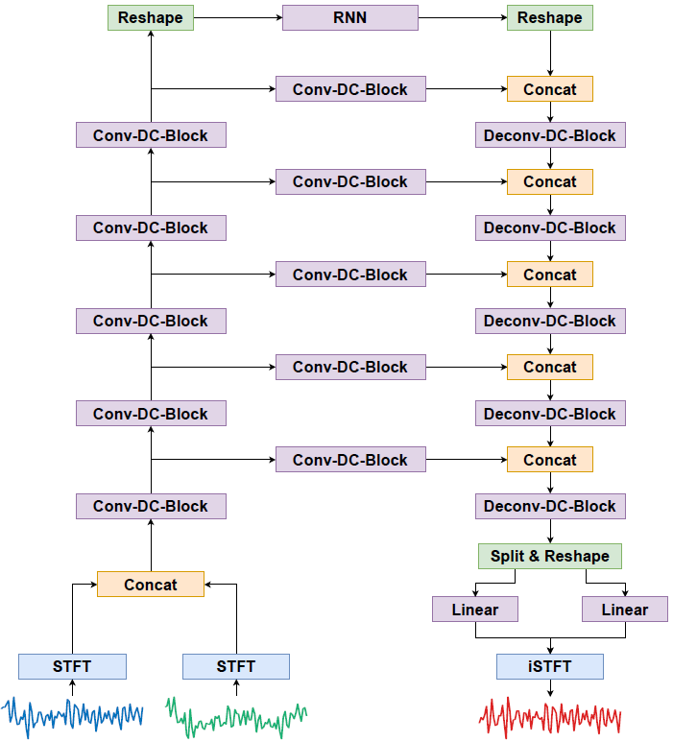
DNN architecture
A RNN with bidirectional LSTM (BLSTM)
Densely-connected convolutional recurrent network (DC-CRN, Tan et al.’21)
Diagram of DC-CRN
Notes:
36
Skip connections from encoder to decoder

Slide 37
Speech dereverberation
Comparisons of approaches on speech dereverberation (T60: 0.0 – 1.0 s)
Notes:
37

Slide 38
Sensitivity to fixed array geometry
A 2-channel array is trained for speech dereverbaratoin with the intermicrophone distance of 10 cm, and tested at the matched and mismatched distances
Performance degrades as distance mismatch increases, as expected. But the trained model does not break down

Slide 39
Speech enhancement with quasi-diffuse noise
Comparisons of approaches on reverberant speech enhancement at -5 dB
Notes:
39

Slide 40
Speech enhancement with quasi-diffuse noise
Comparisons of single- and multi-channel enhancement at different SNRs
Single-channel processing produces expected monaural enhancement results
For the same array layout (e.g. linear arrays), more channels consistently boast performance
Notes:
40

Slide 41
Interim summary of results
Postfiltering substantially elevates beamforming results based on T-F masking and CSM
DC-CRN clearly outperforms BLSTM
Traditional beamforming, even with oracle spatial information, is not competitive
Spectrospatial filtering using MC-CSM produces competitive results compared to DNN based beamforming with postfiltering

Slide 42
Two-talker speaker separation
LBT (location-based training) assigns the speaker with smaller azimuth to the first DNN output layer and the other speaker to the second output layer
LBT resolves permutation ambiguity through naturally available spatial cues, and performs similarly to uPIT
Notes:
42

Slide 43

Speech enhancement demo
8-channel speech enhancement with quasi-diffuse noise at -5 dB
Unprocessed:
MB TI-MVDR (DC-CRN):
MB TI-MVDR + PF (DC-CRN):
CSM TI-MVDR + PF (DC-CRN):
MC-CSM (DC-CRN):
Clean
Notes:
43

Slide 44
Summary
A neural spectrospatial filter is proposed for multi-channel speech dereverberation, speech enhancement, and speaker separation
Multi-channel complex spectral mapping is a conceptually simple, computationally efficient, and effective approach
MC-CSM reduces to monaural CSM when only single-microphone recordings are available, hence treating multi-channel and single-channel processing exactly in the same way
Neural spectrospatial filtering lets deep learning discover most discriminative spectral and spatial features for performing speech separation tasks

